Slide 1

EDA COURSE PROJECT
Title: Superstore dataset
Guided By: Mr. Sunil V.G
Team 11
Name | USN | Roll number
Devaj | 01FE21BCI055 | 153
Debanshu Behera | 01FE21BCI035 | 133
Vishesh Singh | 01FE21BCI036 | 134
Manglam | 01FE21BCI041 | 139
Gayatri | 01FE21BCI062 | 159

Slide 2
Contents
Introduction
Problem statement
Objectives
Data description
Dataset overview
Data pre processing
Data visualization
Feature selection
Prediction models
Conclusion
Colab notebook and kaggle dataset
School of Computer Science and Engineering

Slide 3
Introduction
With our dataset, we aim to develop a predictive model to accurately predict profit. By analyzing historical sales data and key factors, we seek to empower the business with valuable insights for informed decision-making, resource optimization, and strategic planning, ultimately maximizing profitability.
School of Computer Science and Engineering

Slide 4
Problem statement
Perform exploratory data analysis on the Superstore dataset, provide meaningful visualizations and identify the key factors which affect profit, thereby making a prediction model which predicts profit.
School of Computer Science and Engineering

Slide 5
Objectives
Clean and preprocess the dataset for analysis.
Explore and visualize key trends and patterns within dataset.
Present the findings in a clear and concise manner, supported by visualizations.
Understanding which features most strongly influence profit, which can be valuable for the store owner.
Primary aim is to predict the class(profit, loss, neutral) to which the given input belongs.
School of Computer Science and Engineering

Slide 6
Data description
The dataset provided for this project contains comprehensive information about sales of an American superstore.
Customer name, sales, quantity, profit, order date, ship date are some of the attributes of the dataset.
This dataset provides us with a rich source of data to explore the relationships and patterns between different attributes.
Link: https://www.kaggle.com/datasets/vivek468/superstore-dataset-final
School of Computer Science and Engineering

Slide 7
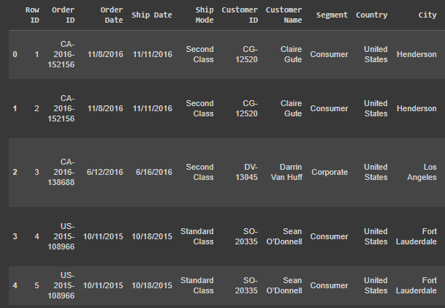
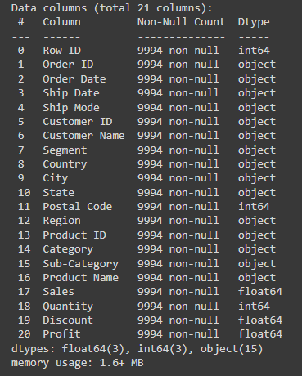
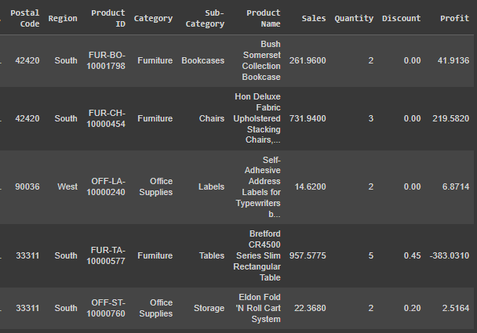
Dataset overview
9994 rows and 21 columns
School of Computer Science and Engineering

Slide 8
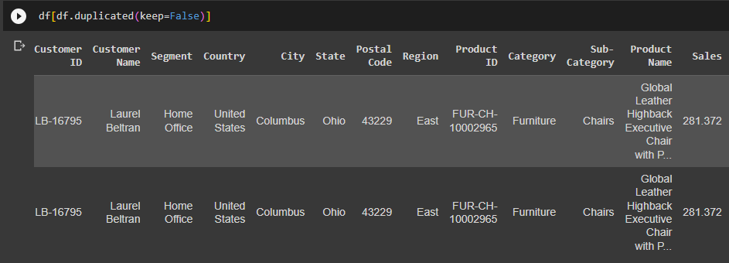
Data preprocessing
There are no NULL values in the dataset.
After deleing the Row ID column we find that there is only one duplicate row in the dataset.
So we drop it.
School of Computer Science and Engineering

Slide 9
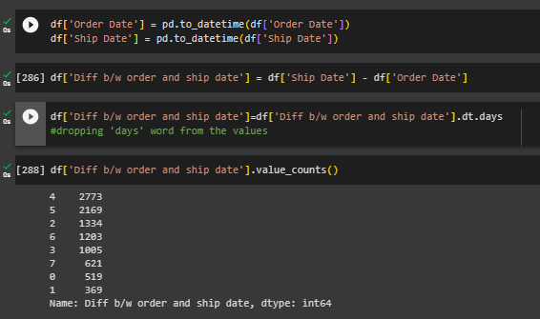
Data preprocessing
Creating a new column which has the difference in days between the order date and ship date.
School of Computer Science and Engineering

Slide 10
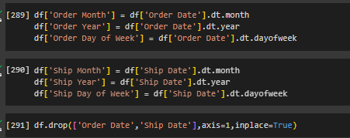
Data preprocessing
Converting the ‘order date’ and ‘ship date’ columns to [‘order month’, ‘order year’, ‘order day of week’] and [‘ship month’, ‘ship year’, ‘ship day of week’] respectively and dropping the ‘order date’ and ‘ship date’ columns.
School of Computer Science and Engineering

Slide 11
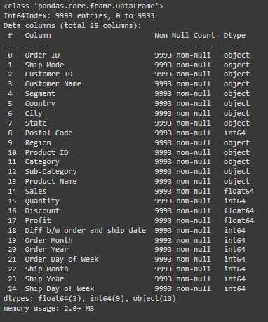
Data preprocessing
Dataset after pre processing has 9993 rows and 25 columns.
School of Computer Science and Engineering

Slide 12
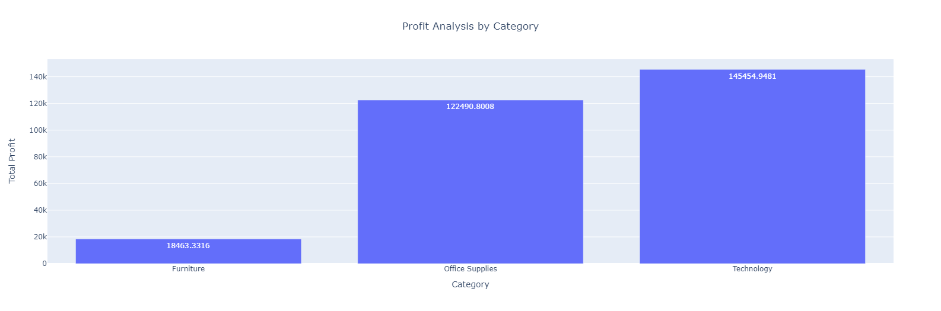
Data Visualization
Fig .01
From this plot we observe that Technology category gives the highest profit and Furniture category gives least profit.
School of Computer Science and Engineering

Slide 13
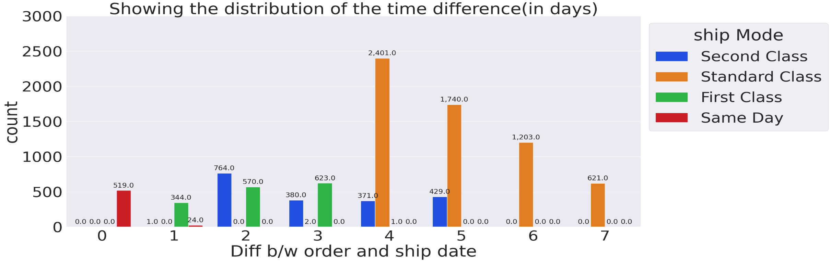
Data Visualization
Fig .02
From the above graph we can observe that for the orders with ship mode as ‘First Class’ the time between order date and ship date was atmost three days. On the other hand the orders which have been shipped through standard class took as high as a week .
School of Computer Science and Engineering

Slide 14
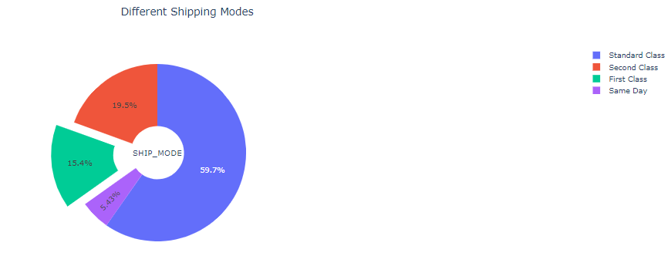
Data Visualization
Fig .03
From this pie chart we come to know that majority of the products have been shipped through ‘Standard Class’ probably because it is the cheapest option.
School of Computer Science and Engineering

Slide 15
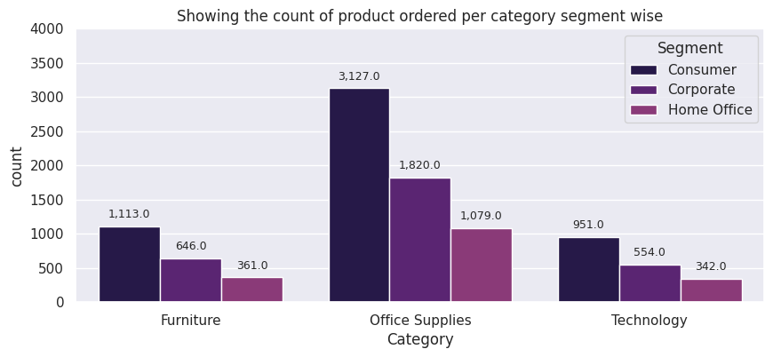
Data Visualization
Fig .03
From this plot we get to know that the consumer segment contributes most towards the number of products bought followed by corporate segment and home office segment in all three categories.
School of Computer Science and Engineering

Slide 16
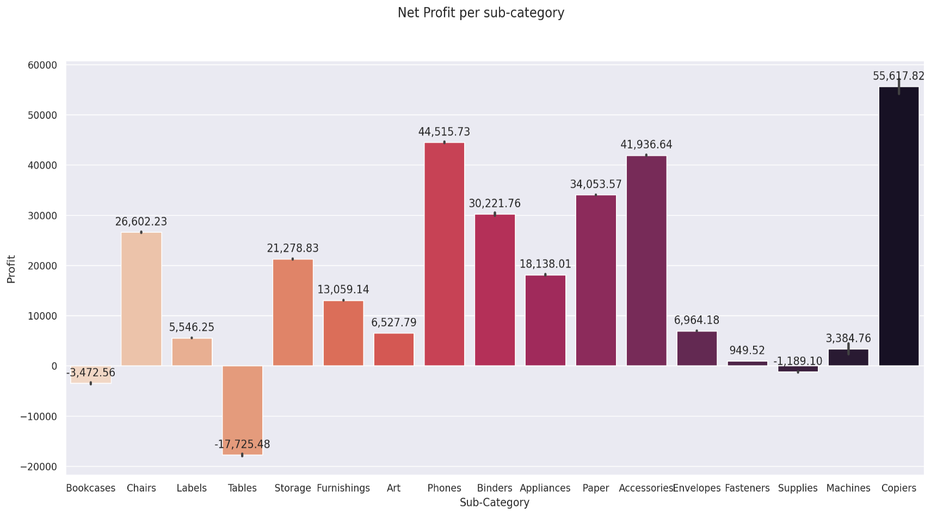
Data Visualization
Fig .05
From this graph we get to know that Copiers provide the most profit and Tables contribute to a huge loss. From the first graph we came to know that furniture provides the least profit. Now we know which furniture contributed towards that. So the owner might need to avoid selling Tables.
School of Computer Science and Engineering

Slide 17
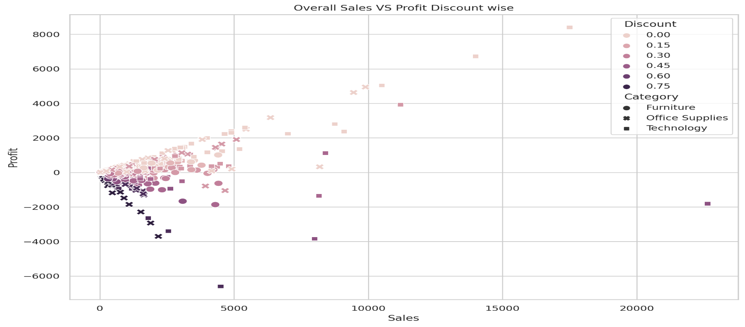
Data Visualization
Fig .06
This scatter plot provides us with great insights about the profit, sales, discount and category. For instance from this scatter plot we get to know that in technology category, discount offered is least and profit gained is highest.
School of Computer Science and Engineering

Slide 18
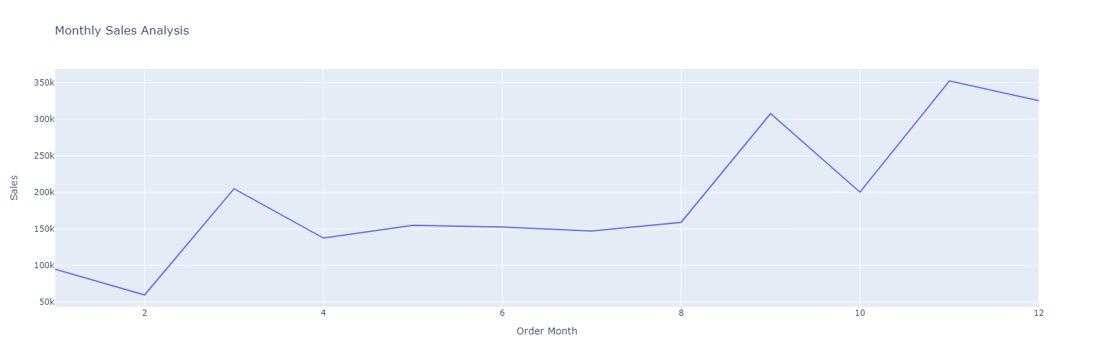
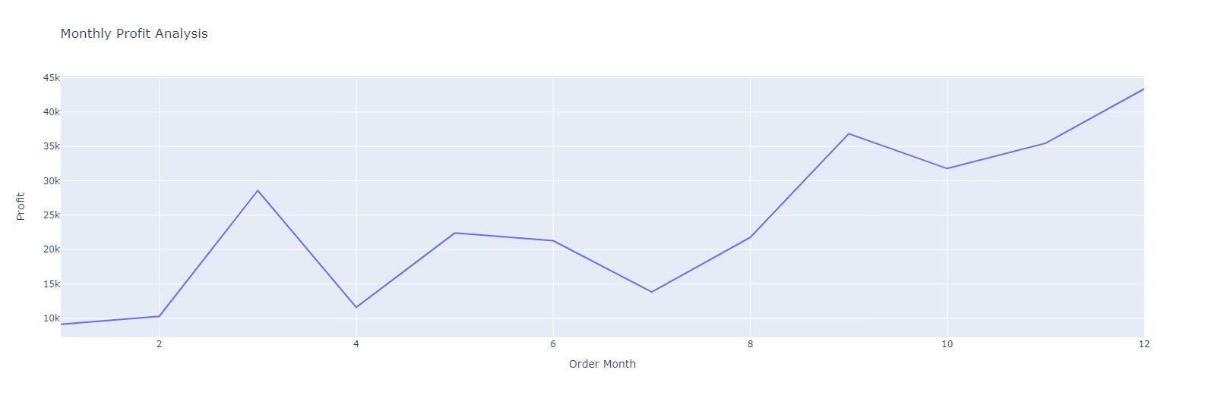
Data Visualization
From these line plot we get to know that in the months of November and December the sales and profit were maximum probably because it is Christmas at that time during which many people shop due to sales and discount.
Also during the months of January and February the sales and profit are minimum probably because people have already shopped in November and December.
This information might help the store owner to keep adequate supplies of products during November and December
Fig .07 a
Fig .07 b
School of Computer Science and Engineering

Slide 19
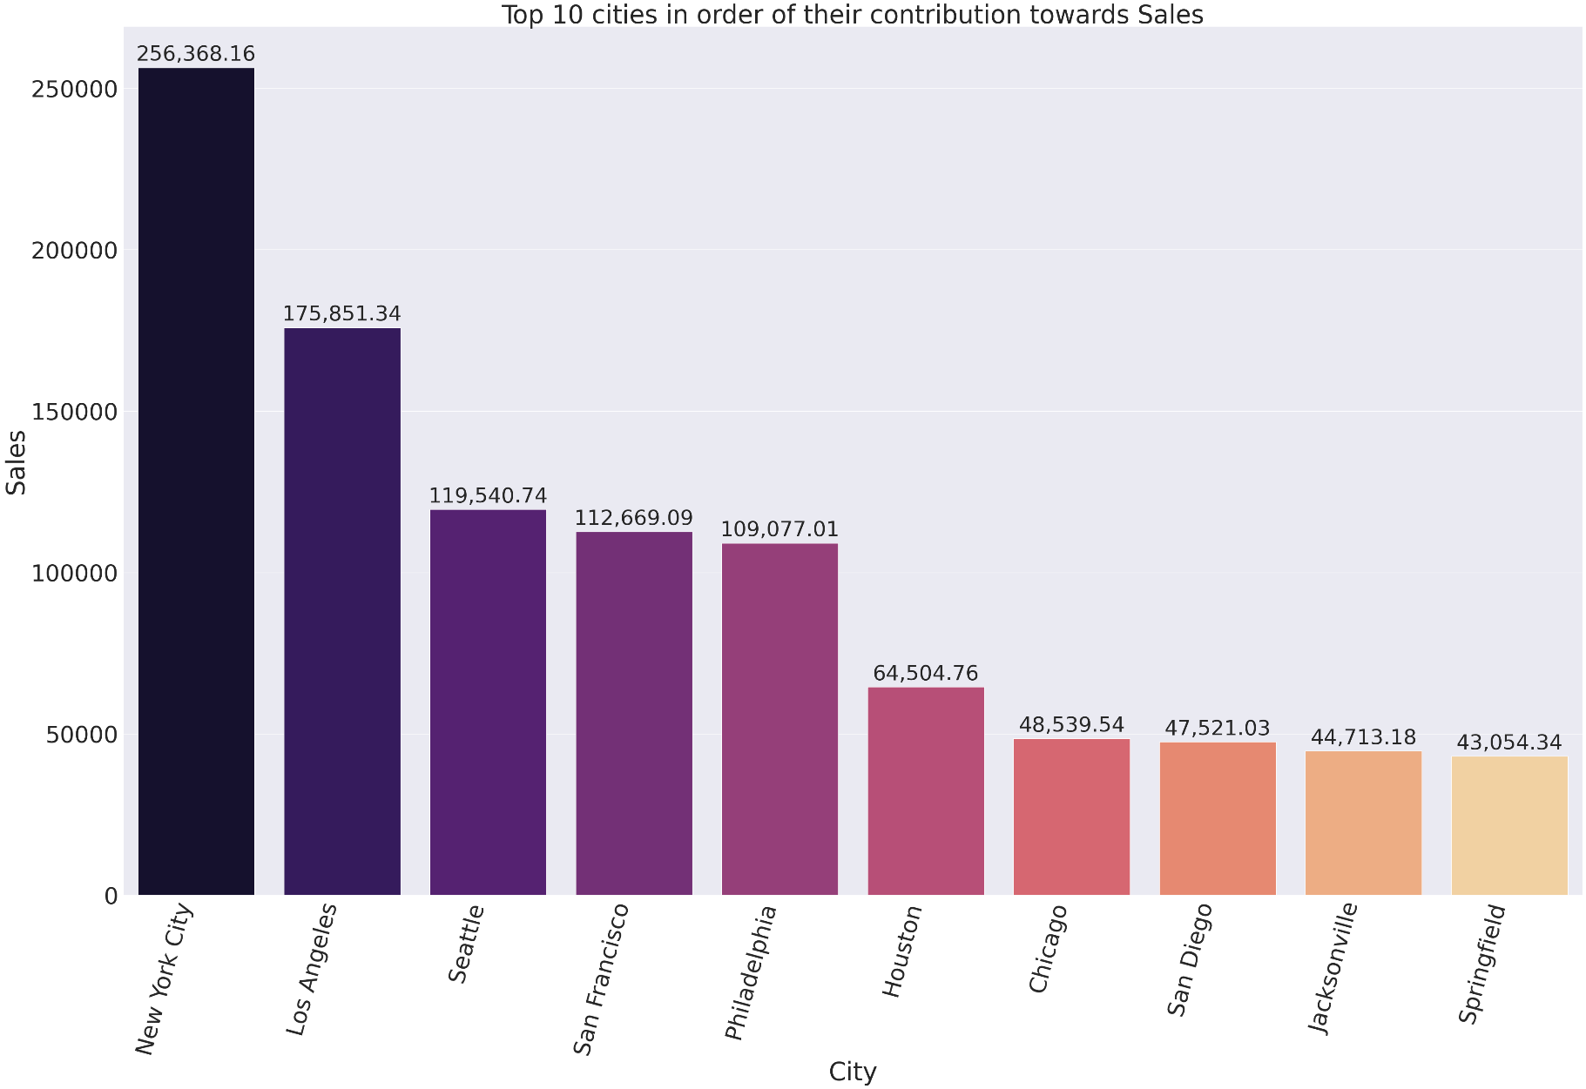
Data Visualization
Fig .08
This plot gives us the top 10 cities in order of their contribution towards sales and New York City contributed the most towards the sales.
School of Computer Science and Engineering

Slide 20
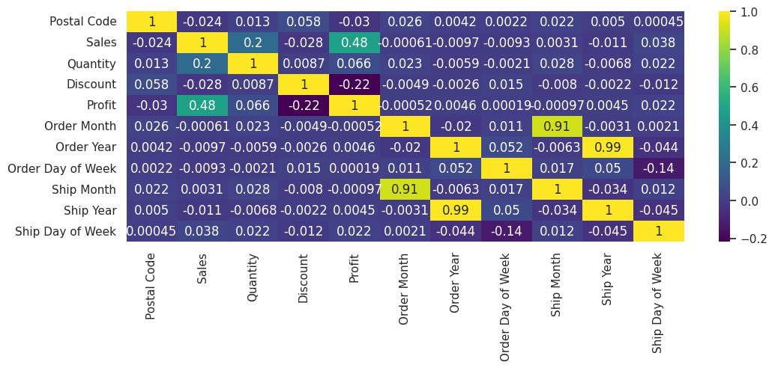
Feature selection
Fig .09
From the correlation heatmap we observe that Sales, Quantity and Discount are the features which impact Profit the most. So we select these three features.
School of Computer Science and Engineering

Slide 21
Prediction models
Independent variables: Sales, Discount, Quantity
Dependent variable: Profit
We have divided the profit column into three classes:
If profit>0 this means there is a profit.
If profit<0 this means there is a loss.
If profit=0 this means there was neither profit nor loss (neutral).
Our aim is to predict in which category the given input falls.
School of Computer Science and Engineering

Slide 22
Prediction models
We used the following algorithms:
Algorithm | Accuracy
K nearest neighbours | 93.27%
Logistic regression | 84.69%
Decision tree | 92.63%
Random Forest | 92.75%
K nearest neighbours gives the highest accuracy i.e. 93.27% .
School of Computer Science and Engineering

Slide 23
Conclusion
The analysis and exploration of the superstore dataset has provided valuable insights into the factors affecting profit in the business. Through the Exploratory Data Analysis (EDA), we gained a deeper understanding of the relationships between sales, quantity, discount, and profit. Additionally, the machine learning models have shown promising results in predicting profit based on these features. The combination of EDA and machine learning models has provided valuable insights into profit prediction and can serve as a foundation for developing more sophisticated strategies to enhance the superstore's overall profitability and success.
School of Computer Science and Engineering

Slide 24
Colab notebook and kaggle dataset
Colab notebook
Kaggle dataset
School of Computer Science and Engineering

Slide 25
Thank You
School of Computer Science and Engineering

